Slide 1

Ad Grants Online Marketing Challenge
Final Project Report
Partnered with FreeGeektwincities.org
Presented by- Group 13

Slide 2
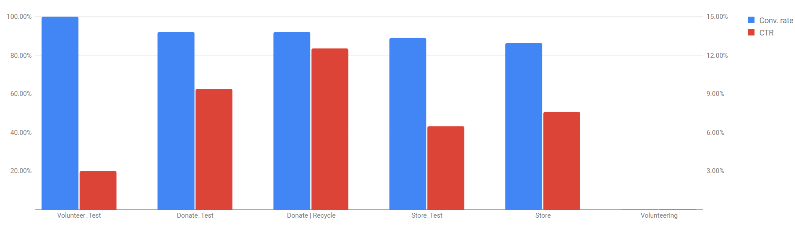
Executive Summary
AIM – To improve the performance of the campaigns and establishing the awareness of the organization’s work towards the betterment of the society
3 AdWords campaigns for 30 days
Optimized campaigns - search and negative keywords
Improved campaign performance using:
  Ad extensions
  Callout extensions
  Call Extensions

Slide 3
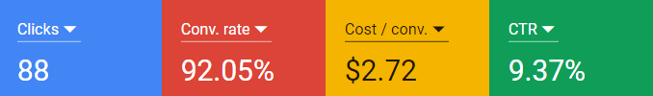


Campaign Overview and Performance
Overview:
Created new ad groups with ad extension
Recommended website improvement with improved content
Performance:
Campaign metrics exceeded both our targets and expectations
Previously for volunteer campaign the conversion rate was zero but now it is 100%
With increase in conversion the cost of conversion went down
Donate
(2 ad groups, 23 ads and extensions)
Store
(4 ad groups, 12 ads and extensions)
Volunteer
(2 ad groups, 5 ads and extensions)

Slide 4
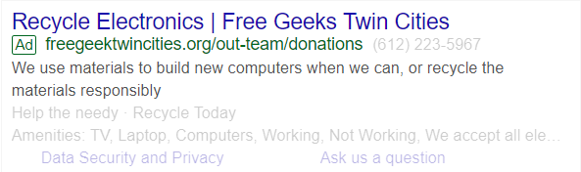
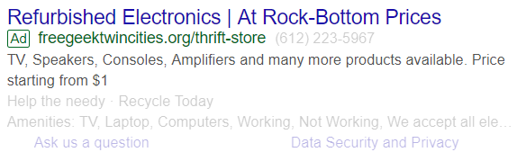
ADWORDS STRATEGIES OVERVIEW
3 new campaigns and 5 strategies to implement
Google Keyword Planner- based on the different campaign we will use the google keyword planner run adwords campaign based on the right keywords
The Keyword Planner and Google Trends may be useful for keyword suggestions and traffic estimates. [Exact] and +modified +broad +match keywords are the planned match types for all Campaigns
Creating ad specific keywords to an adgroup- Combining ads with the landing pages that covers the same topics as the key words in an adgroup
DONATE | STORE | VOLUNTEER
Donate Computer Ad Group [recycling computer] [computer donation mn] [free trash dump] | Computer Ad Group [buy cheap computers] [cheap pc parts] [cheap computer repairs] +used pc | Community Help Ad Group [group volunteer opportunities mn] [group volunteer tie mn] [group volunteer twin cities]
Donate Electronic Ad Group [free tv recycling] [freegeek recycling] [recycle electronic near me] | Laptop Ad Group +used laptops + rent laptop | General Volunteer Ad Group +volunteer position+voluntary work
 | Other Electronics [microcenter refurbished] [amplifier repair shop near me] [cheap electronic store near me] [buy used electronic]

Slide 5
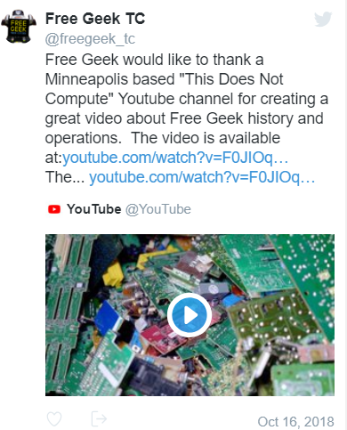
MARKETING GOALS & ACHIEVEMENTS
Campaigns helped improve donations and increased volunteer turnout
Volunteer Ad group performance was drastically improved creating awareness for the recycle program.
Based on the mission of organization which is donate, recycle and recruit people for social work we created campaigns with the same goals
By the performance of the Volunteer campaign, they have recruited 3 interns for the hardware assembly and training purpose
With the performance and outcome results of the campaign we would highly recommend the organization to continue use some of the campaign that we have generated

Slide 6
Recommended Next Steps
Google AdWords proved to be a powerful tool in maximizing organization presence due to which we would recommend them to continue using this platform for continuous digital marketing.
Recommendations :
AdWords
Ad and Extensions content Improvement – Comparison between pre campaign and post campaign impressions and clicks suggests ad content improvement as a good choice.
Increasing budget for volunteer campaign creates community awareness leading to more donations.
Website
Reduce Bounce Rate – Improving landing pages and keeping the content precise and more graphic
Interactive Homepage – Static homepage reduces visitors interest.

Slide 7
LEARNING OUTCOME
Learning Objective & Outcomes:
We as a team found the Google Online Marketing Challenge(GOMC) as an opportunity to gain knowledge and experience of using Google Analytics, Google Ad Words and Facebook Ads.
After collaborating with non-profit, our aim was to increase awareness of the given object and achieve our goal successfully and this was done by setting various goals, creating strategies, selecting keywords for ads and optimizing their campaigns
Group Dynamics:
Our GOMC Team comprised of five members, each of which was of a different age and mindset which had their own and unique ideas. We as a team decided that the campaigns, keywords and designing of ads would be handled by 3 members, 2 members would work on optimization and budgeting required to run the campaigns.
Though we worked on different campaigns, regular face-to-face meetings ensured sharing of each campaign’s details and progress to keep everyone informed about the overall progress of Google AdWords.
Client Dynamics:
We found FreeGeek to be an apt client for our GOMC because despite having the accolades mentioned on the website page it lacked the awareness among people and didn’t do much in market.
Future Recommendation:
As we mentioned earlier also that regular website development and content management is quite necessary to improve the website experience and enhance the Ad Words campaigns.

